Slide 1

Project 1 - QAP Software Development Keyin College
Dave Husk @ dave.husk@keyin.com
Sept 14, 2023

Slide 2
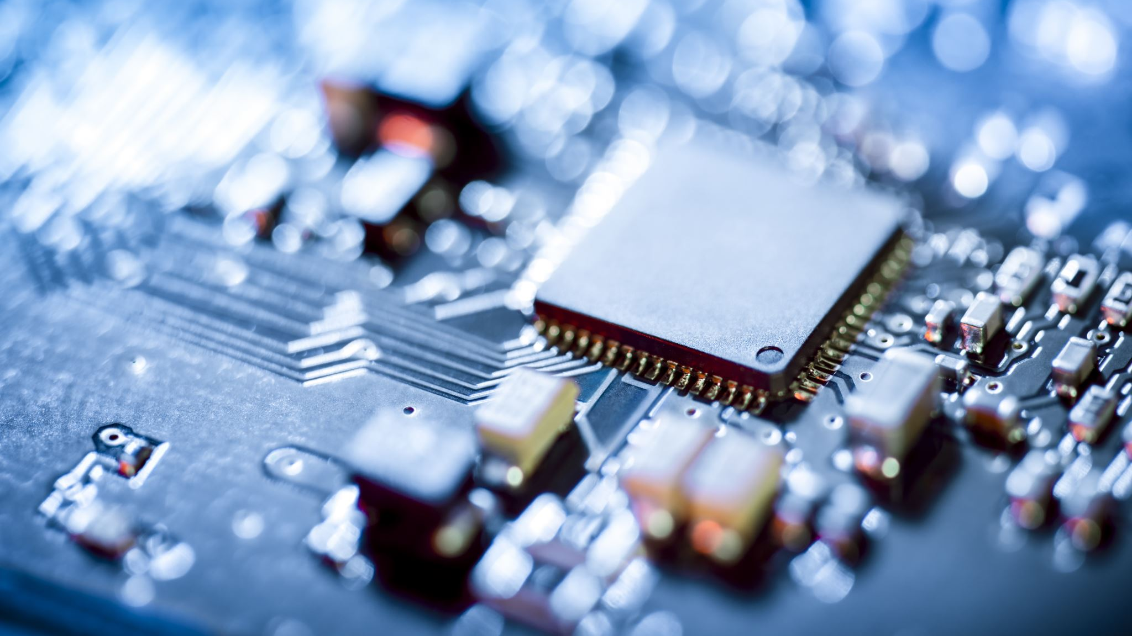
Computer components

Slide 3
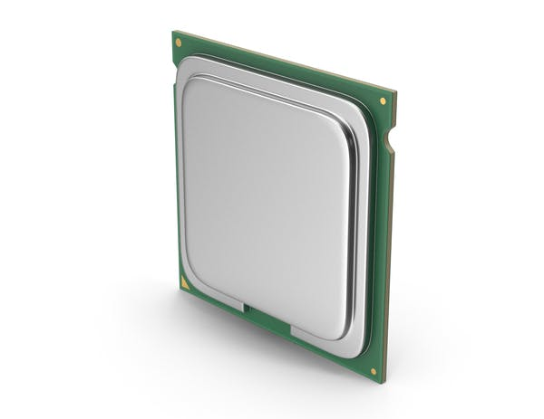
Central Processing Unit (CPU)
What it is: The brain of the computer.
What it does: Executes instructions of a computer program.
Interesting Fact: The first commercially available CPU was the Intel 4004, released in 1971.
Analogy: Think of the CPU as the manager of a company. It handles a variety of tasks, makes decisions, and ensures everything runs smoothly. It's versatile and can handle many different types of tasks but might not be the fastest at any specific one.

Slide 4
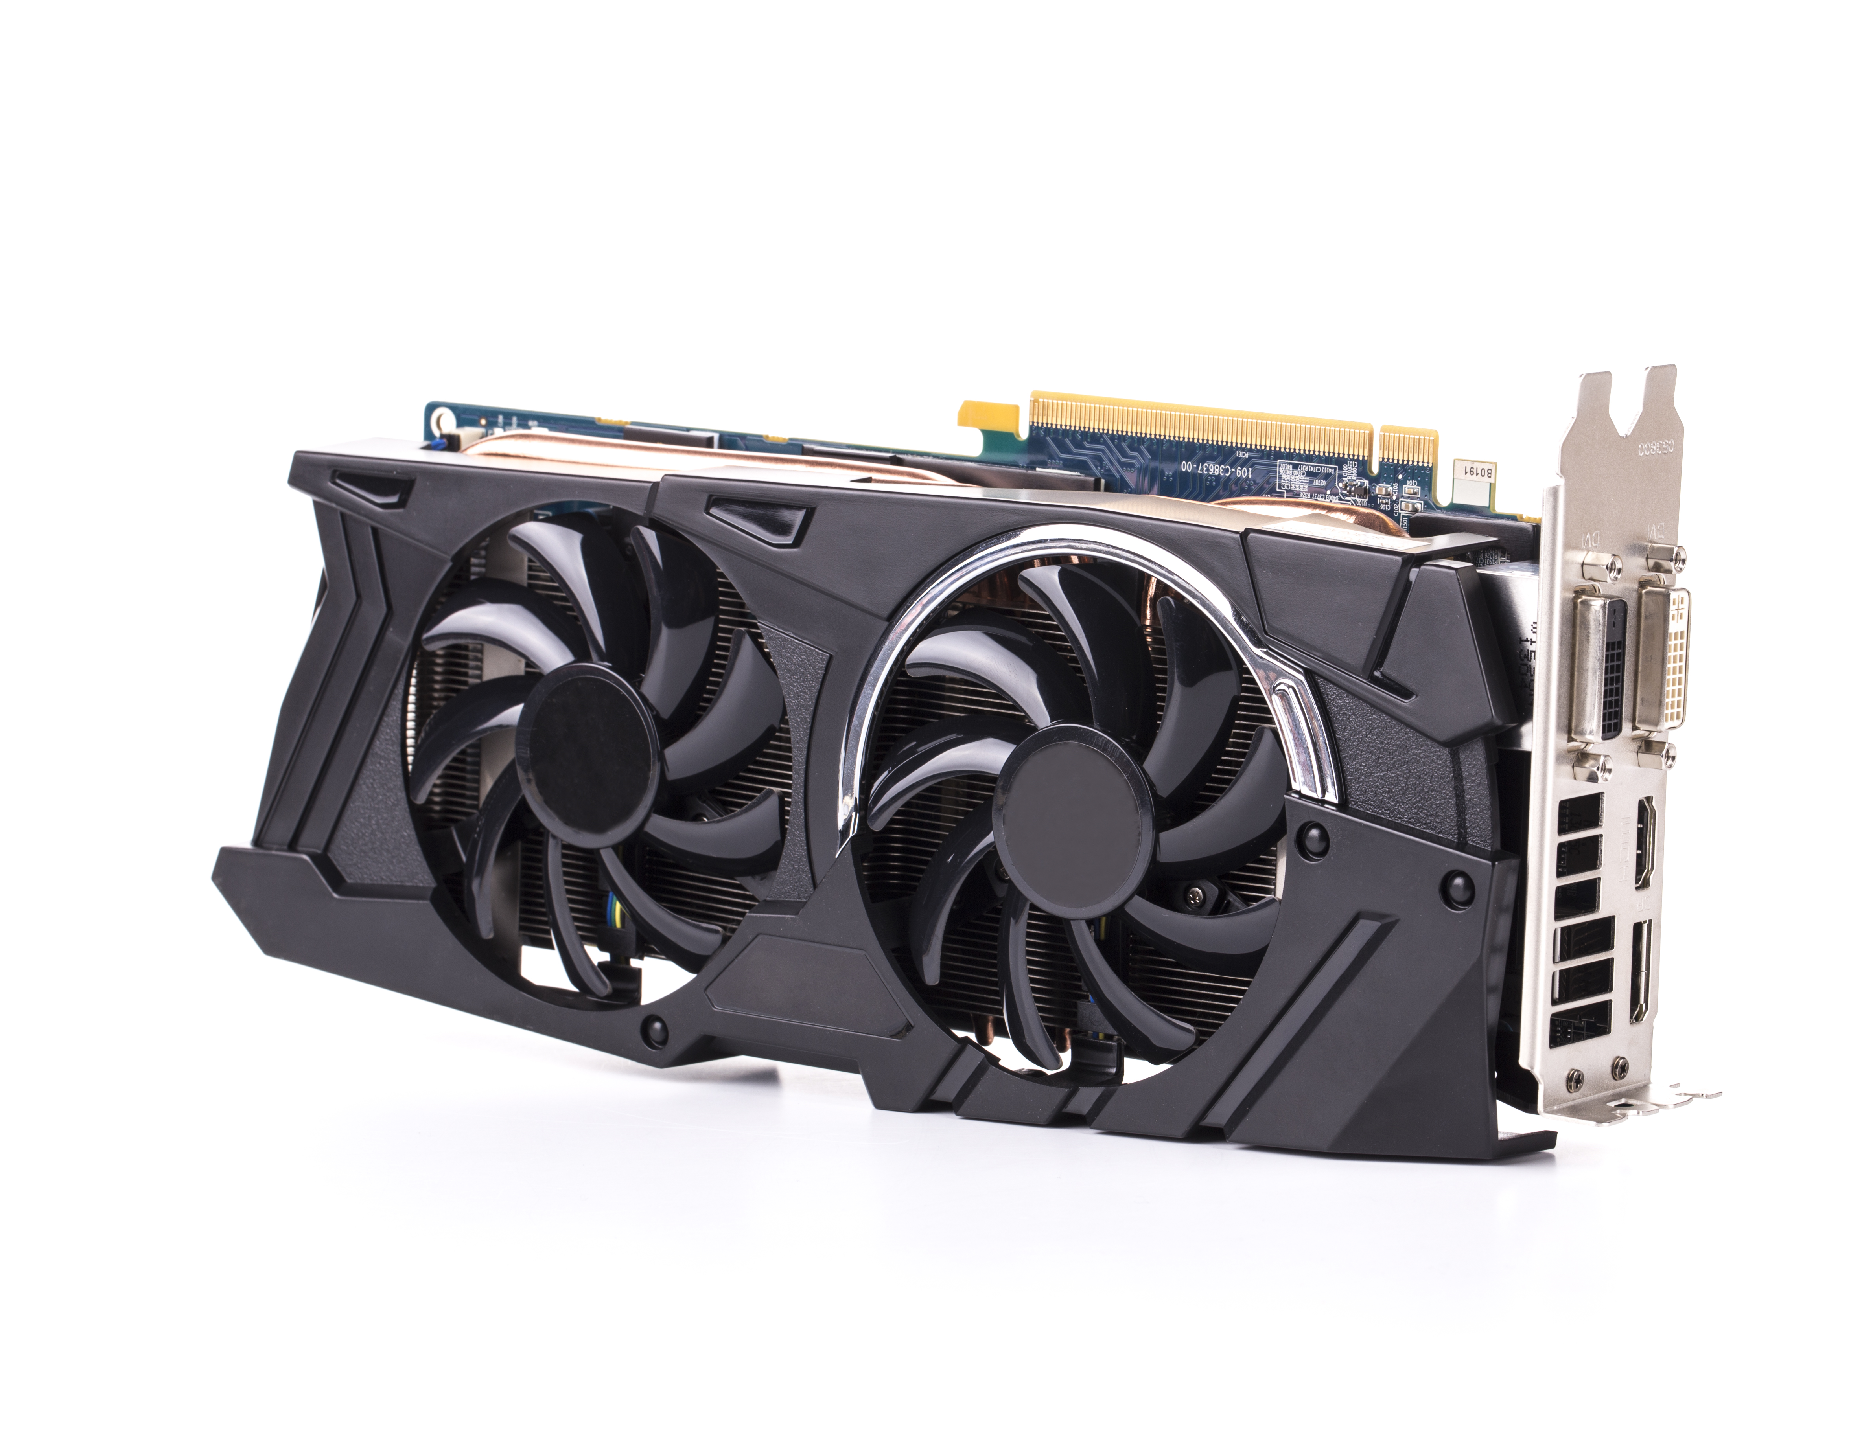
GRAPHICAL Processing Unit (GPU)
What it is: A specialized electronic circuit designed to accelerate the processing of images and videos.
What it does: Renders graphics and manages how the visuals are displayed on the monitor.
Interesting Fact: NVIDIA's GeForce 256, released in 1999, is considered the first GPU.
Analogy: The GPU is like a team of workers specialized in a specific task. Each worker does a similar job, and together, they can process a large number of similar tasks very quickly. It's like having a team of artists who all paint the same scene simultaneously, each handling a different part of the canvas.

Slide 5
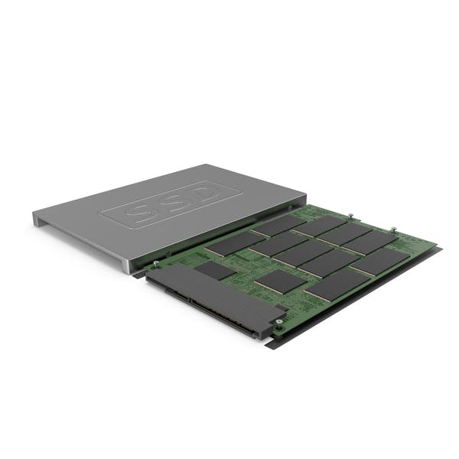
solid STATE DRIVE (SSD)
What it is: A specialized electronic circuit designed to accelerate the processing of images and videos.
What it does: Renders graphics and manages how the visuals are displayed on the monitor.
Interesting Fact: NVIDIA's GeForce 256, released in 1999, is considered the first GPU.
Analogy: The GPU is like a team of workers specialized in a specific task. Each worker does a similar job, and together, they can process a large number of similar tasks very quickly. It's like having a team of artists who all paint the same scene simultaneously, each handling a different part of the canvas.

Slide 6
Historical events for technology

Slide 7
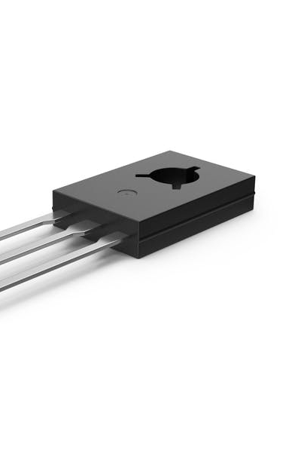
Invention of the Transistor (1947):
Technical Details: The transistor is a semiconductor device made of silicon or germanium. It operates by allowing or blocking the flow of electrical current.
Methodology: The first transistors were point-contact transistors, created by pressing two gold leaf contacts onto a germanium semiconductor.
Challenges: Early transistors were fragile and not suitable for mass production. The invention of the bipolar junction transistor (BJT) in the 1950s addressed these issues.
Implications: Transistors led to the development of integrated circuits, which are the building blocks of modern electronic devices.

Slide 8
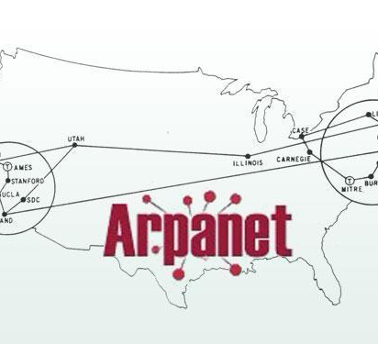
Launch of ARPANET (1969)
Technical Details: ARPANET used the packet switching method to transmit data, breaking down messages into smaller packets, sending them separately, and reassembling them at the destination.
Methodology: The initial ARPANET connected four major computers at universities in the southwestern US (UCLA, Stanford Research Institute, UCSB, and the University of Utah).
Challenges: The main challenge was creating a robust network that could continue functioning even if parts of it were damaged or destroyed.
Implications: The protocols developed for ARPANET, especially TCP/IP, became the standard for all internet communication.

Slide 9
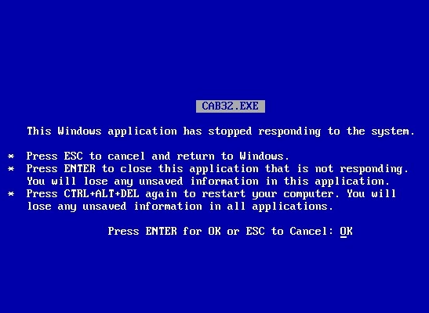
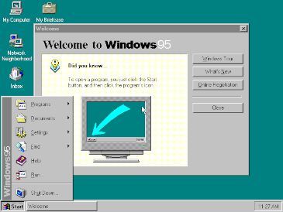
Release of Windows 95 (August 24, 1995) ← My 12th b-day!
Technical Details: Windows 95 was Microsoft's first 32-bit operating system with a fully integrated graphical user interface. It introduced the Start button, taskbar, and the concept of "plug and play" for hardware devices.
Methodology: Built on the foundation of MS-DOS, Windows 95 was designed to be more user-friendly and accessible. It utilized pre-emptive multitasking, allowing multiple applications to run simultaneously without crashing the system.
Challenges: One of the most notorious challenges was the Blue Screen of Death (BSOD). It's an error screen displayed when the system encounters a fatal system error from which it cannot recover. The BSOD became synonymous with system crashes in Windows 95, often requiring a restart.
Implications: Despite its challenges, Windows 95 was a significant leap forward in personal computing. It set the standard for subsequent Windows operating systems and played a crucial role in solidifying Microsoft's dominance in the OS market.

Slide 10
Technological catastrophe’s

Slide 11
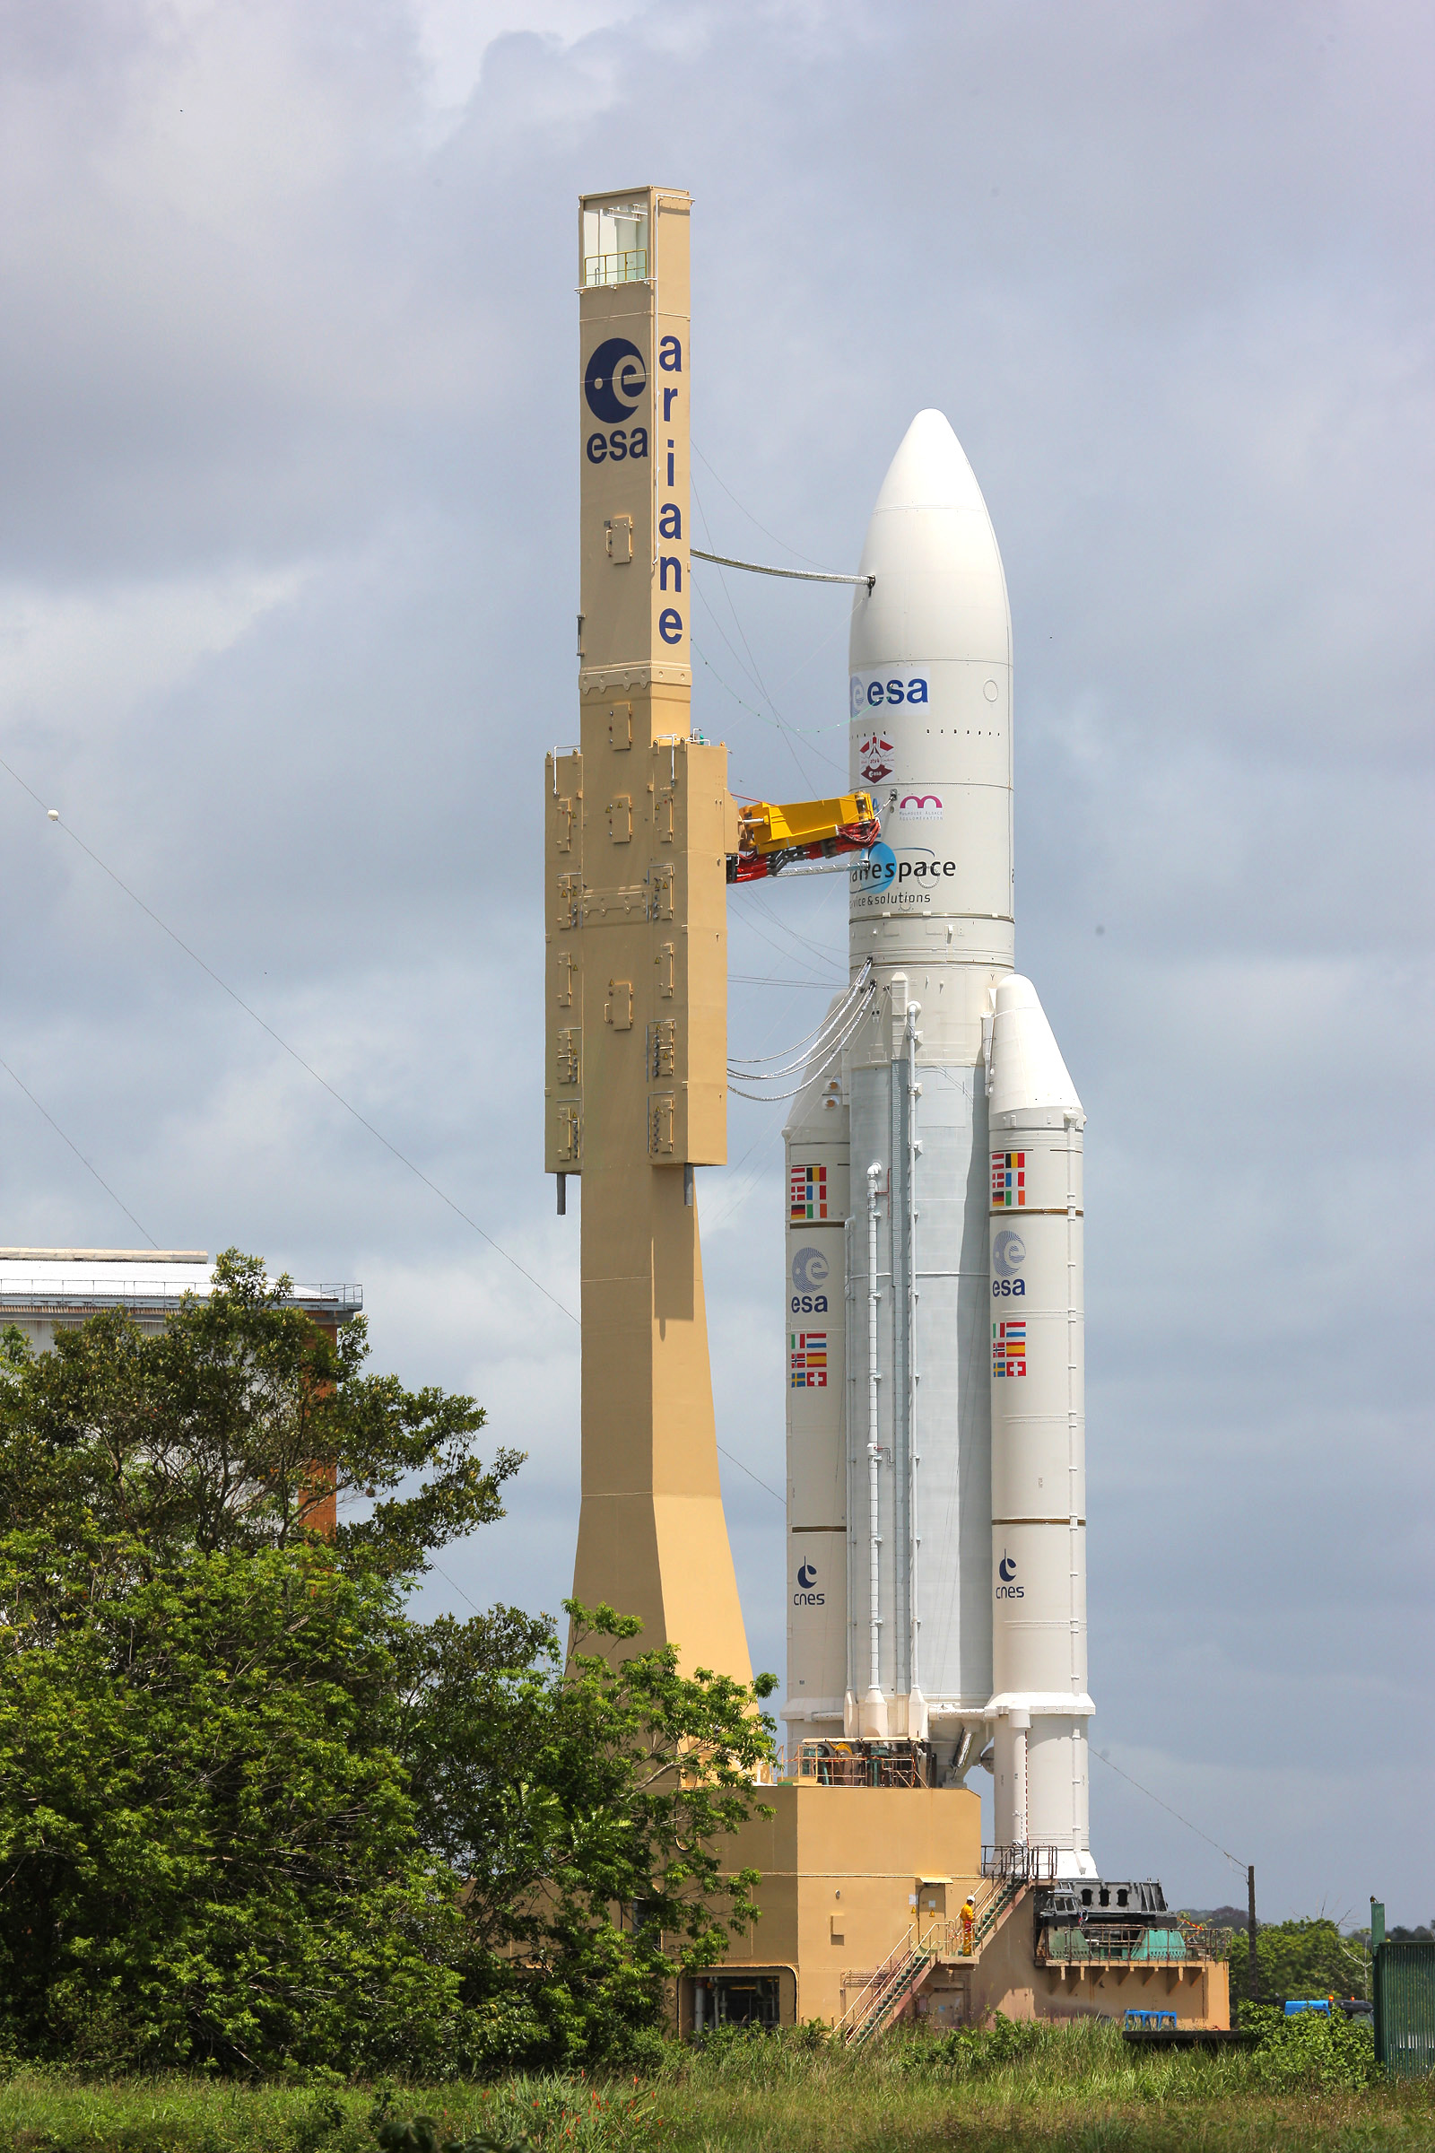
The Ariane 5 Rocket Explosion (1996)
Event/Person Associated with the Failure: The European Space Agency's maiden flight of the Ariane 5 rocket.
Damage: The rocket self-destructed just 40 seconds after launch, leading to a loss of more than $370 million.
How It Could Have Been Prevented/Fixed: Proper software testing and simulation using the actual flight system could have identified the error. The software from the Ariane 4 rocket was reused without adequate testing for the Ariane 5's different flight conditions.
Interesting Fact: The specific software error that caused the explosion was considered "non-critical" because it was related to the rocket's backup system. However, when the primary system failed, the backup system's error led to the explosion.

Slide 12
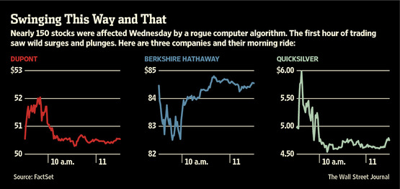

The Knight Capital Trading Disaster (2012)
Event/Person Associated with the Failure: Knight Capital Group, an American global financial services firm.
Damage: The company executed millions of unintended trades over a 45-minute period, resulting in a loss of over $440 million.
How It Could Have Been Prevented/Fixed: Proper software deployment practices, rigorous testing in staging environments, and having rollback procedures in place could have prevented the disaster. The software update meant for a dormant system should never have been deployed to a live trading system without thorough testing.
Interesting Fact: The financial loss from this incident was so severe that it nearly bankrupted Knight Capital. The company was eventually acquired by another firm.

Slide 13
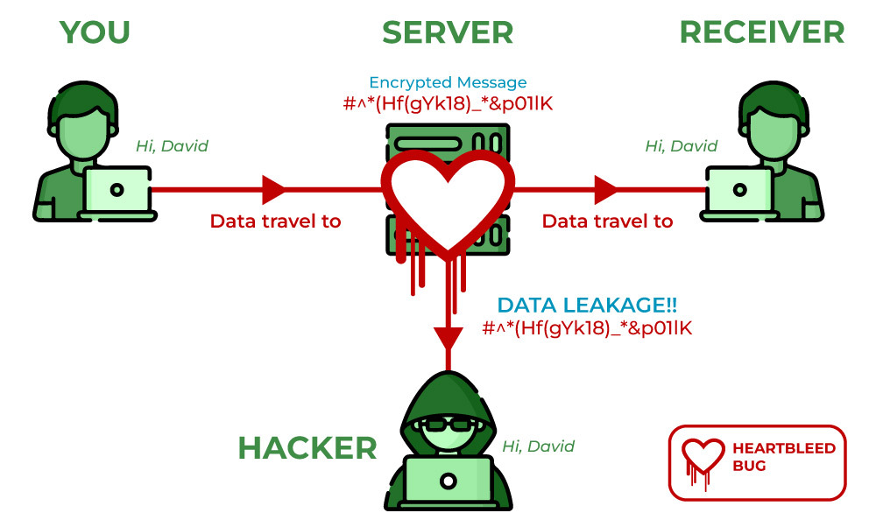
The Heartbleed Bug (2014)
Event/Person Associated with the Failure: A vulnerability in the OpenSSL cryptography library, which is widely used in internet servers.
Damage: Potentially exposed millions of passwords, credit card numbers, and other sensitive information. Many websites and users had to update their passwords and security certificates.
How It Could Have Been Prevented/Fixed: Regular security audits, code reviews, and employing static analysis tools could have identified the missing bounds check in the code. After its discovery, a patch was quickly released to fix the vulnerability.
Interesting Fact: Despite its potential for damage, there's no evidence that the Heartbleed bug was exploited maliciously before its public disclosure. However, its discovery led to a massive, coordinated response to patch vulnerable systems.

Slide 14
Software development careers

Slide 15

Software Developer
Job Title: Software Developer
Description & Responsibilities:
Design, write, and test computer programs.
Work with other developers, designers, and stakeholders to create software solutions.
Debug and maintain existing software.
Stay updated with the latest programming techniques and technologies.
Job Outlook & Salary Expectations:
Expected to grow 22% from 2019 to 2029.
Median annual wage of $107,510 in 2019.

Slide 16

SYSTEMS ANALYST
Job Title: Systems Analyst
Description & Responsibilities:
Study an organization's current computer systems.
Design solutions to help the organization operate more efficiently.
Work closely with management to prioritize business goals and information needs.
Test and deploy new systems.
Job Outlook & Salary Expectations:
Expected to grow 7% from 2019 to 2029.
Median annual wage of $90,920 in 2019.

Slide 17

DATABASE ADMINISTRATOR (DBA)
Job Title: Database Administrator (DBA)
Description & Responsibilities:
Use specialized software to store and organize data.
Ensure data's availability, security, and performance.
Backup and restore data.
Identify user needs and set up new databases.
Job Outlook & Salary Expectations:
Expected to grow 10% from 2019 to 2029.
Median annual wage of $93,750 in 2019.

Slide 18
Essential programming topics

Slide 19

The Importance of Integrating AI in Software Development (My own topic)
Adaptive User Experiences: AI can analyze user behavior to create personalized and adaptive user interfaces, enhancing user satisfaction and engagement.
Automated Testing and Quality Assurance: AI-driven tools can predict where bugs might occur and automate the testing process, ensuring higher software quality.
Predictive Analytics: AI can process vast amounts of data to provide insights, helping developers understand user needs and predict future trends.
Enhanced Security: AI algorithms can detect unusual patterns and potential security threats, offering real-time protection against cyber-attacks.
Optimized Code: AI can assist in code optimization, ensuring efficient use of resources and faster software performance.
Natural Language Processing (NLP): Integration of chatbots and virtual assistants to provide real-time assistance and enhance user interaction.
Continuous Learning and Improvement: Machine learning models can continuously learn from user interactions, leading to software that evolves and improves over time.
Resource Management: AI can predict system overloads and optimize resource allocation, ensuring smooth software operation.
Accessibility: AI-driven tools can enhance software accessibility, making applications usable for people with disabilities.
Future-Proofing: As technology evolves, integrating AI ensures that software remains relevant and competitive in the market.
Interesting Fact: According to Gartner, AI augmentation will create $2.9 trillion of business value and 6.2 billion hours of worker productivity globally by 2021.

Slide 20

Thank you
I'm developing a platform influenced by my ongoing software development studies in college.
My aim is to create a transparent platform that addresses societal barriers with a unique concept I've devised.
This platform will not only promote sustainability and equal access to resources but also bridge the open-source community to become the foundation of future leadership.
It's designed to enhance existing systems, not replace them, ensuring everyone can achieve their full potential
Stay tuned!

